Slide 1
M.KUMARASAMY COLLEGE OF ENGINEERING , KARUR.
Register Number :927623BEC058 . 927623BEC302
Name :GOKULRAJ B , DARSAN SANJAI SR
Date :06.06.2025

Slide 2
TITLE OF THE PROJECT
CAR RENTAL SYSTEM

Slide 3
Abstract
The Car Rental System is a database-driven application that manages car availability, customer bookings, and payments. It stores essential details like customer information, car status, rental records, and transactions. Users can browse, book, and pay for rentals easily. The system ensures efficient and secure management of car rentals.

Slide 4
Literature Review
Year | Authors | Title of the Paper | Algorithm/ Methodologies/ Techniques | Findings
2016 | Kumar, S., & Soni, D. | A Comparative Study of Online Car Rental Systems | Comparative analysis, case study method | Identified functional modules like vehicle listing, booking, and feedback in rental systems.
2011 | Elmasri, R., & Navathe, S. B. | Fundamentals of Database Systems (6th Edition) | ER modeling, normalization, SQL querying | Established database design concepts used in backend systems like car rental applications.

Slide 5
Problem(s) Identified
Inefficient manual recordkeeping for car availability, bookings, and user data.
Increased operational delays and customer dissatisfaction.
Lack of centralized control and real-time updates in conventional systems.
Security risks with physical record maintenance and manual payments.

Slide 6
Proposed Solution
Develop a dynamic and responsive web application to :
Handle user registration, login, car listings, and booking requests.
Enable digital payments and live booking confirmations.
Provide role-based access for users and administrators.
Store and manage data in a structured relational database.
Enhances accessibility, user experience, and admin control.

Slide 7
Objectives
Enable users to book vehicles from anywhere via the web.
Minimize human error and paperwork through automated processes.
Provide real-time booking status, feedback, and payment handling.
Secure user data and allow only authenticated access.
Support scalability and maintainability for future enhancements.

Slide 8
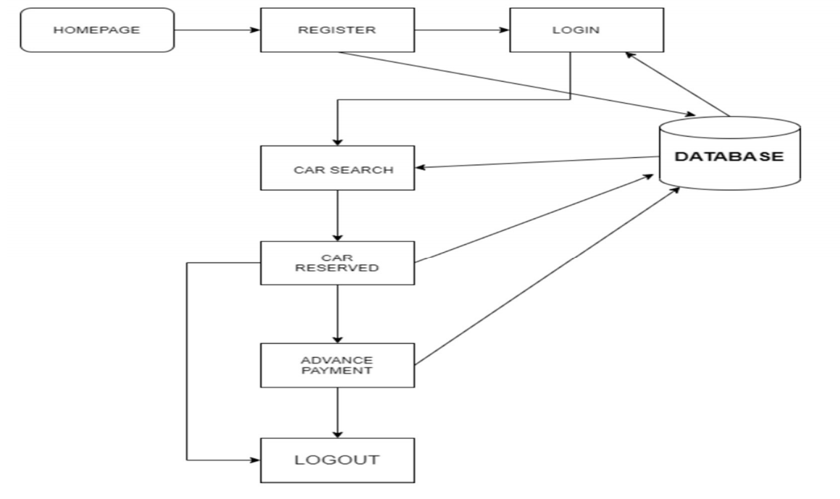
Architecture Diagram

Slide 9
Architecture Diagram Explanation
Users/Admins initiate requests via the UI.
PHP Scripts handle server-side logic to process input.
MySQL Database stores and retrieves structured data.
Admin privileges allow:
Car addition, deletion
Booking approval/rejection
User management

Slide 10
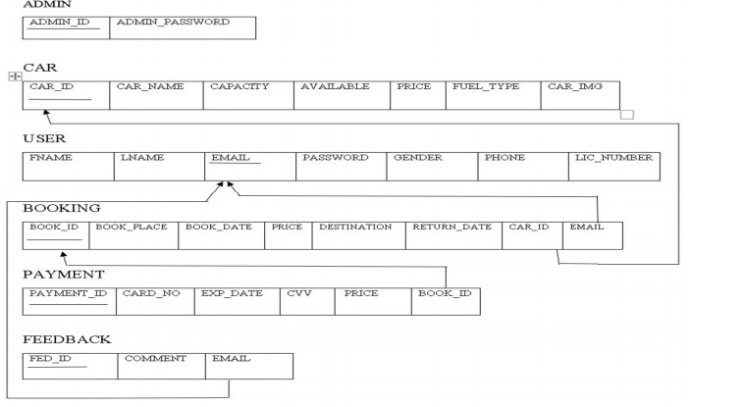
Schema Diagram

Slide 11
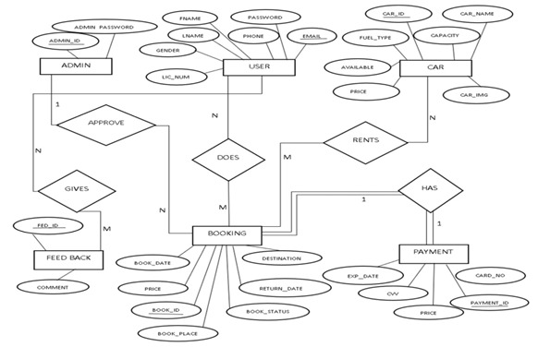
ER diagram

Slide 12
Software Description
Frontend:
HTML5 for structure
CSS3 for design/styling
JavaScript for interactivity and form validation
Backend:
PHP handles server-side processing
MySQL for relational database management
Server:
Apache (via XAMPP) to host and test locally
Tools:
Visual Studio Code, Bootstrap framework for UI components

Slide 13
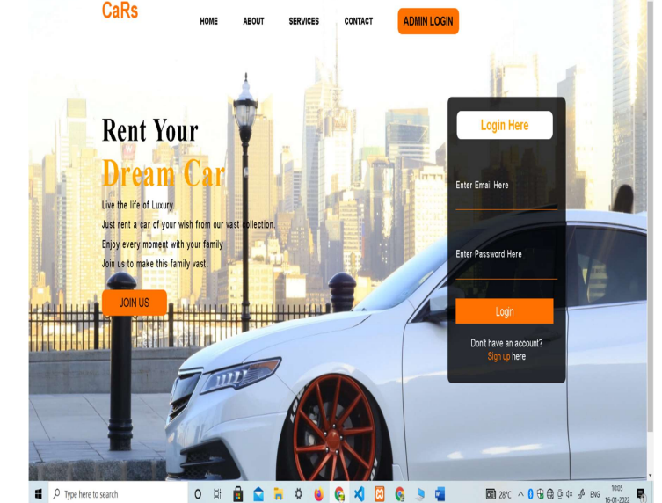
Results & Discussion
It indicates the home page of our website Cars. This contains navigation bar,through which can navigate to other pages. It also contains some details about the website at the home page.

Slide 14
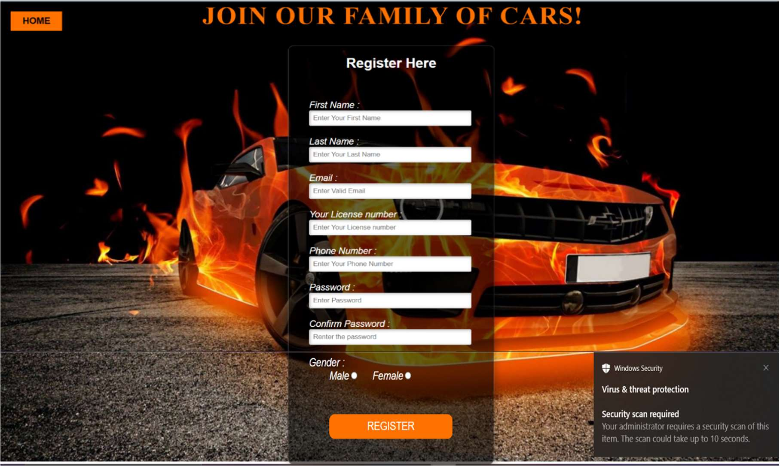
Results & Discussion
It indicates the user registration page. It asks the user to enter the details like first name, last name, email, license number, phone number, password,
confirm password and gender.

Slide 15
Conclusion
In conclusion, the Car Rental System has been developed successfully and meets the key objectives of automating the car rental process, improving operational efficiency, and providing a user-friendly interface for customers and rental agencies. The system integrates a relational database to manage data, processes payments securely, and allows for real-time updates of car availability and booking statuses. The system is scalable and can be expanded in the future to include additional features, such as mobile access or more advanced analytics. The implementation of the Car Rental System represents a significant step toward modernizing and streamlining car rental operations, ultimately leading to better customer experiences and enhanced business efficiency.

Slide 16
Reference
Elmasri, R., & Navathe, S. B. (2011). Fundamentals of database systems (6th ed.). Pearson.
Forbes, A. (2014). The joy of PHP programming: A beginner's guide to programming interactive applications with PHP and MySQL (5th ed.). CreateSpace Independent Publishing Platform.
Connolly, T., & Begg, C. (2015).Database Systems: A Practical Approach to Design, Implementation, and Management (6th ed.). Pearson Education.
Ullman, J. D., & Widom, J. (2008).A First Course in Database Systems (3rd ed.). Pearson.Covers database fundamentals, relational algebra, normalization, and database design principles.

